Slide 1

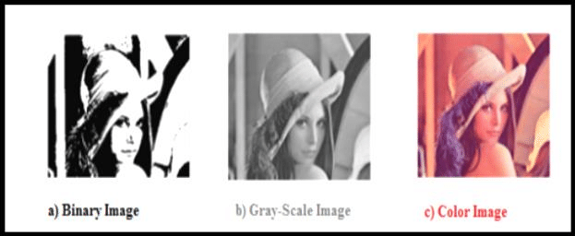
Digital Image Processing
images can be classified depending on their colors and bit representations give a detailed explanation for this classification.
Gray scale (0 to 255) levels of gray color
RGB ( 3 matrices)
Black and white (0,1) pixels

